Slide 1
Lecture 11 Disk Scheduling
Manya Gidwani

Slide 2
Disk Structure
Disk drives are addressed as large 1-dimensional arrays of logical blocks, where the logical block is the smallest unit of transfer.
The 1-dimensional array of logical blocks is mapped into the sectors of the disk sequentially.
Sector 0 is the first sector of the first track on the outermost cylinder.
Mapping proceeds in order through that track, then the rest of the tracks in that cylinder, and then through the rest of the cylinders from outermost to innermost.

Slide 3
Disk Scheduling
The operating system is responsible for using hardware efficiently — for the disk drives, this means having a fast access time and disk bandwidth.
Access time has two major components
Seek time is the time for the disk are to move the heads to the cylinder containing the desired sector.
Rotational latency is the additional time waiting for the disk to rotate the desired sector to the disk head.
Disk bandwidth is the total number of bytes transferred, divided by the total time between the first request for service and the completion of the last transfer.

Slide 5
Disk Scheduling Algorithm
FCFS
SSTF
SCAN
CSCAN
CLOOK

Slide 6
Disk Scheduling (Cont.)
Several algorithms exist to schedule the servicing of disk I/O requests.
We illustrate them with a request
98, 183, 37, 122, 14, 124, 65, 67
Head pointer 53

Slide 7
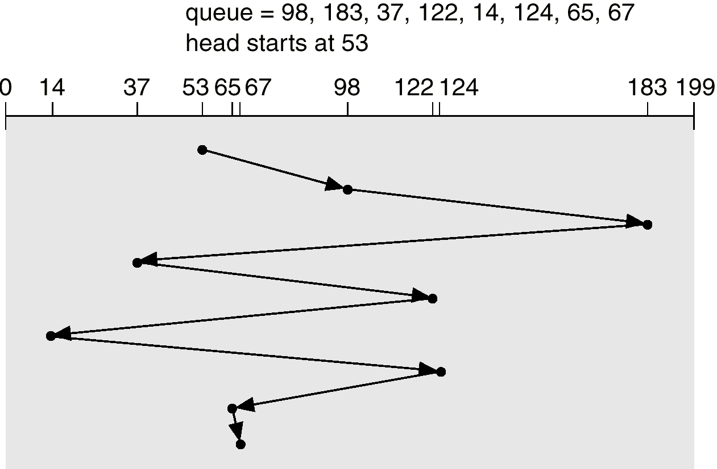
FCFS
Illustration shows total head movement of 640 cylinders.

Slide 8
SSTF
Selects the request with the minimum seek time from the current head position.
SSTF scheduling is a form of SJF scheduling; may cause starvation of some requests.
Illustration shows total head movement of 236 cylinders.

Slide 9
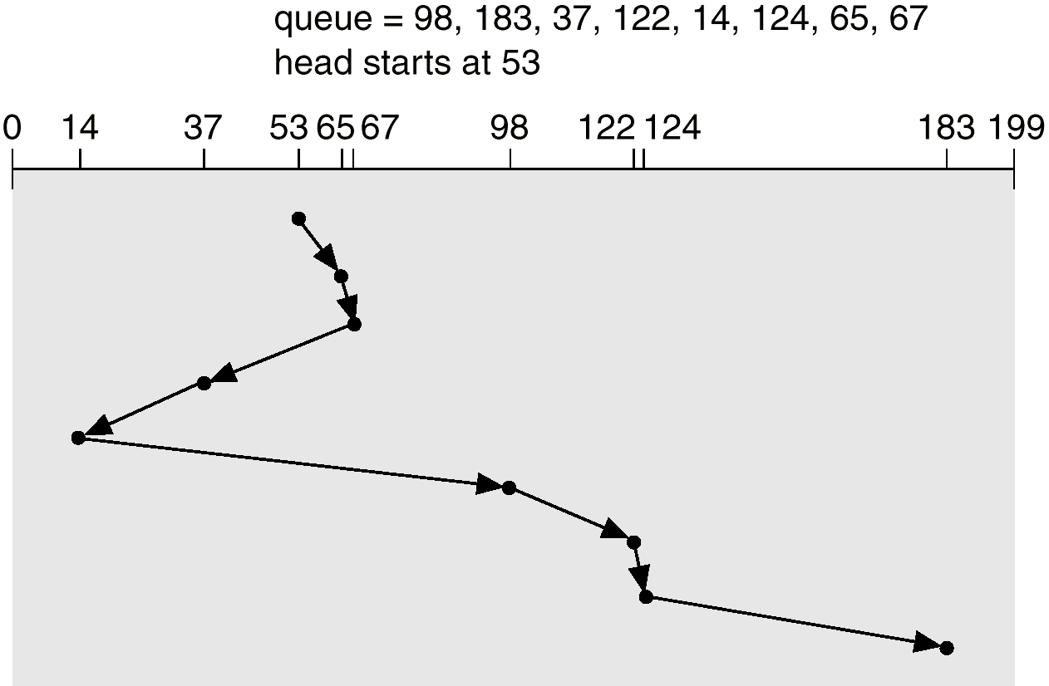
SSTF (Cont.)

Slide 10
SCAN
The disk arm starts at one end of the disk, and moves toward the other end, servicing requests until it gets to the other end of the disk, where the head movement is reversed and servicing continues.
Sometimes called the elevator algorithm.
Illustration shows total head movement of 208 cylinders.

Slide 11
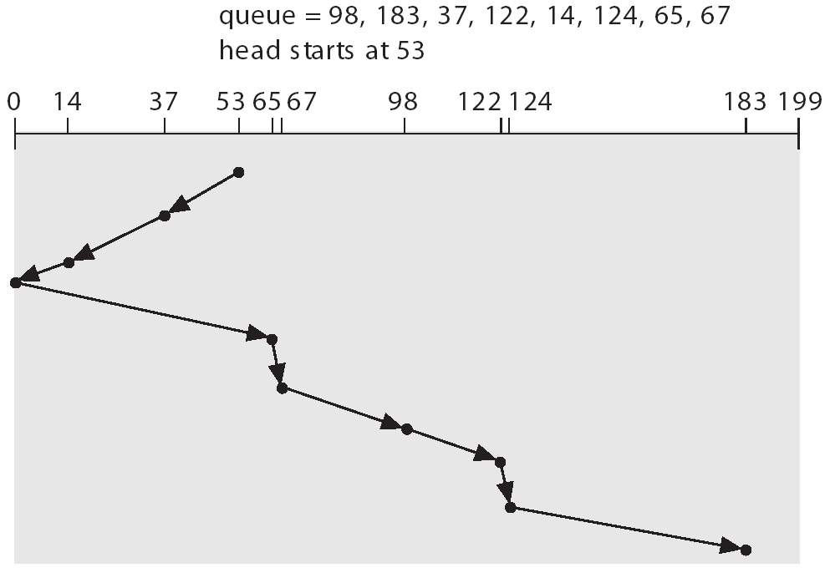
SCAN (Cont.)

Slide 12
C-SCAN
Provides a more uniform wait time than SCAN.
The head moves from one end of the disk to the other. servicing requests as it goes. When it reaches the other end, however, it immediately returns to the beginning of the disk, without servicing any requests on the return trip.
Treats the cylinders as a circular list that wraps around from the last cylinder to the first one.

Slide 13
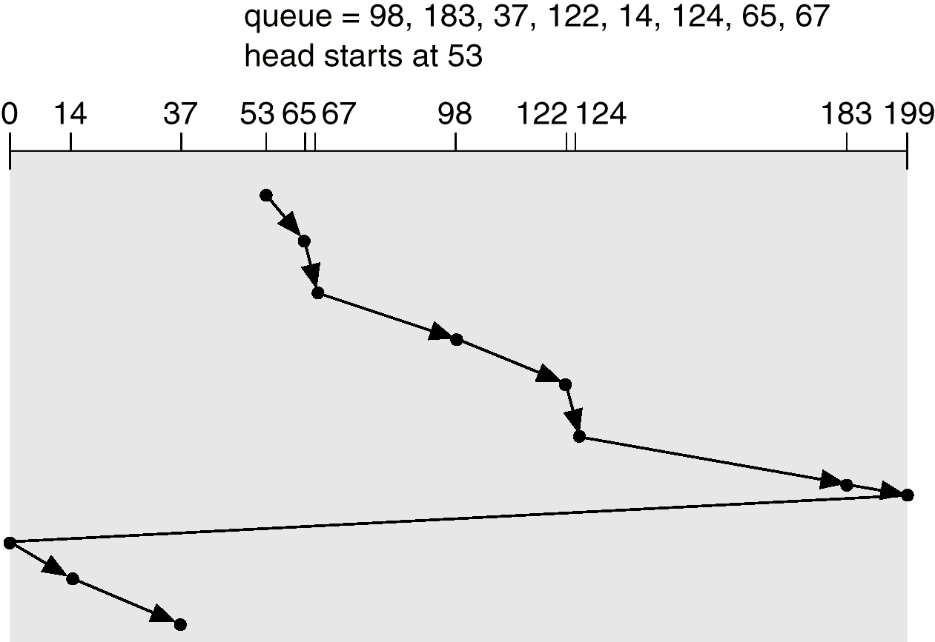
C-SCAN (Cont.)

Slide 14
C-LOOK
Version of C-SCAN
Arm only goes as far as the last request in each direction, then reverses direction immediately, without first going all the way to the end of the disk.

Slide 15
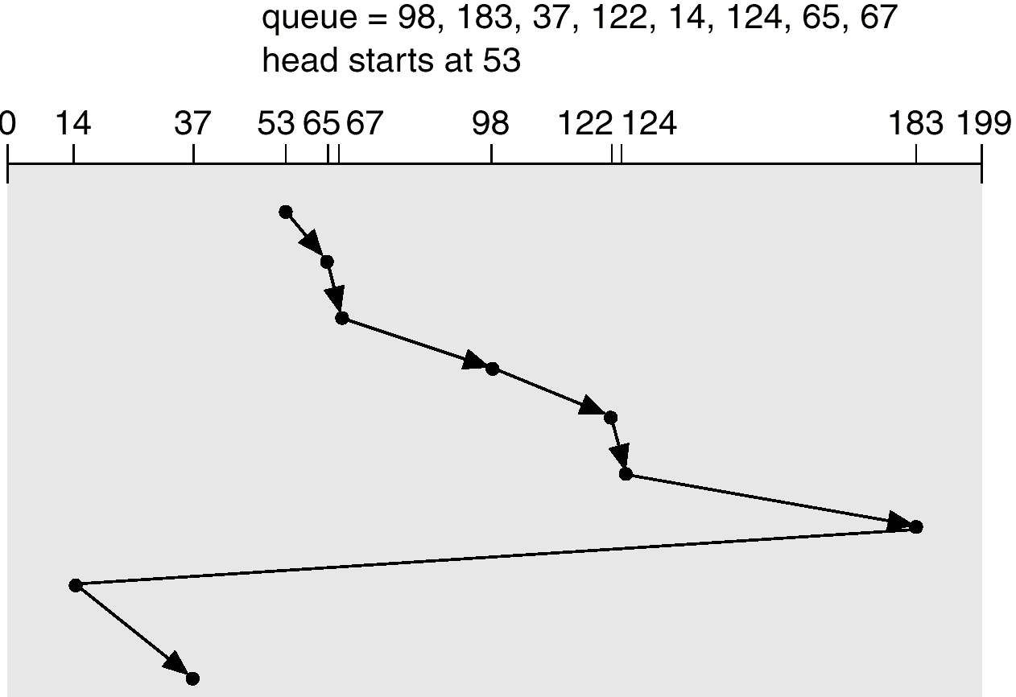
C-LOOK (Cont.)

Slide 16
Selecting a Disk-Scheduling Algorithm
SSTF is common and has a natural appeal
SCAN and C-SCAN perform better for systems that place a heavy load on the disk.
Performance depends on the number and types of requests.
Requests for disk service can be influenced by the file-allocation method.
The disk-scheduling algorithm should be written as a separate module of the operating system, allowing it to be replaced with a different algorithm if necessary.
Either SSTF or LOOK is a reasonable choice for the default algorithm.

Slide 17
Thank U

